Slide 1
Zentangle

Slide 2
What is zentangle?
creating beautiful images by drawing structured patterns.
miniature pieces of unplanned, abstract, black and white art
created with repetitive patterns
Unplanned yet surprising
No up or down, can be viewed and drawn from any orientation

Slide 3
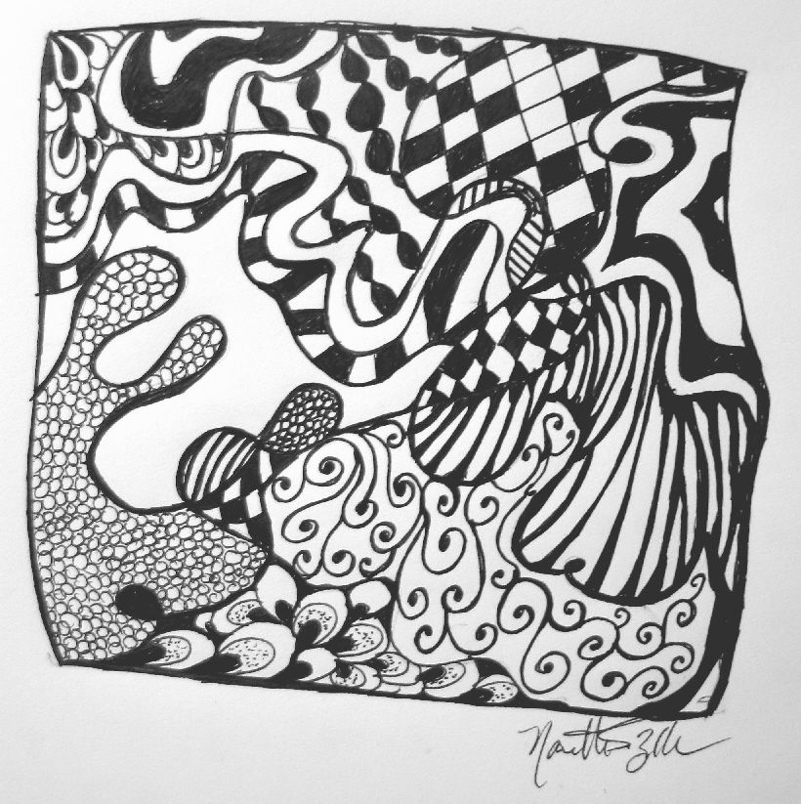

Slide 4
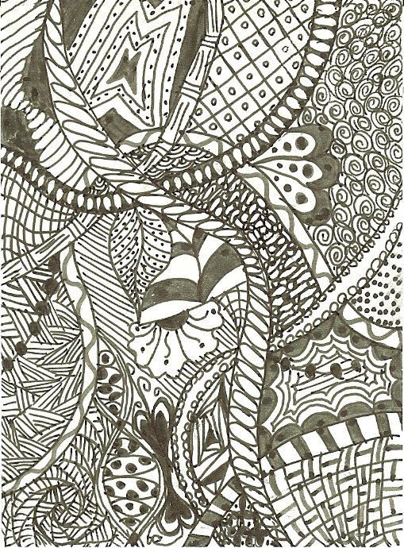

Slide 5
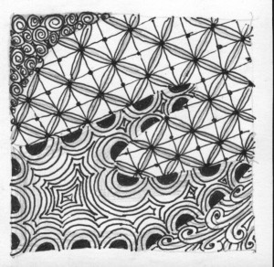

Slide 6
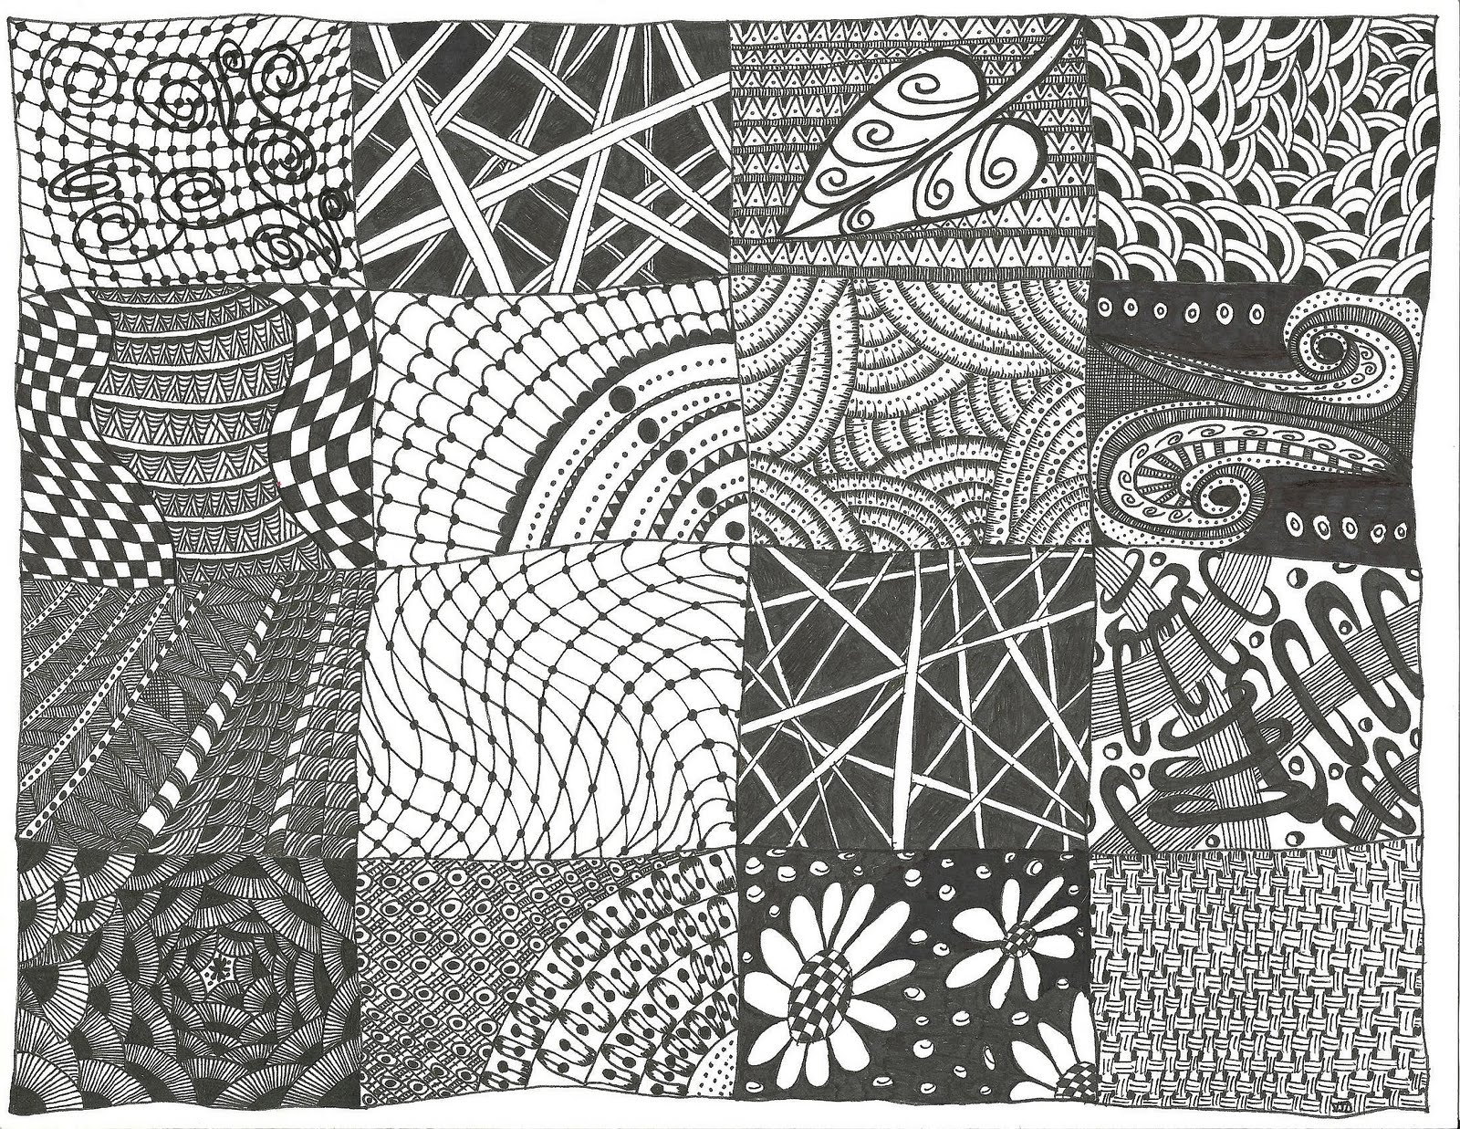

Slide 7
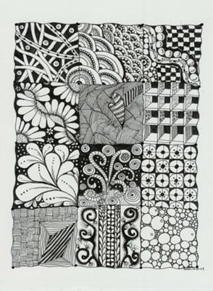

Slide 8
