Slide 1
Zentangles Step by Step
By Mrs. Crandell

Slide 2
Step 1: Get your materials

Slide 3
Step 2: Draw an outline shape

Slide 4
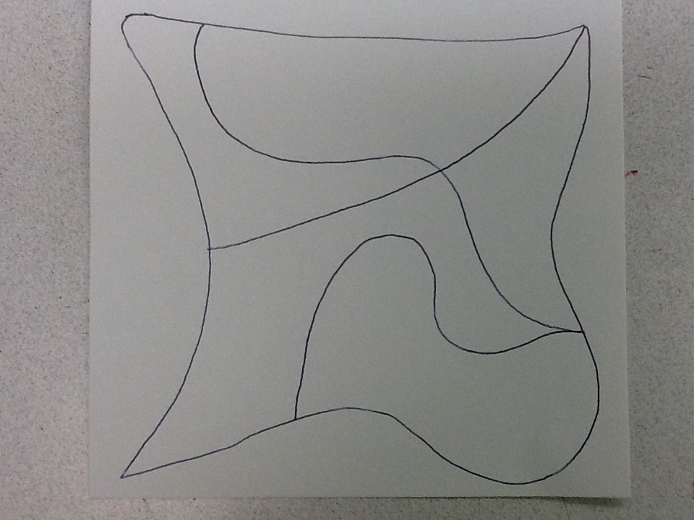
Step 3: Draw in dividing lines- be creative!

Slide 5
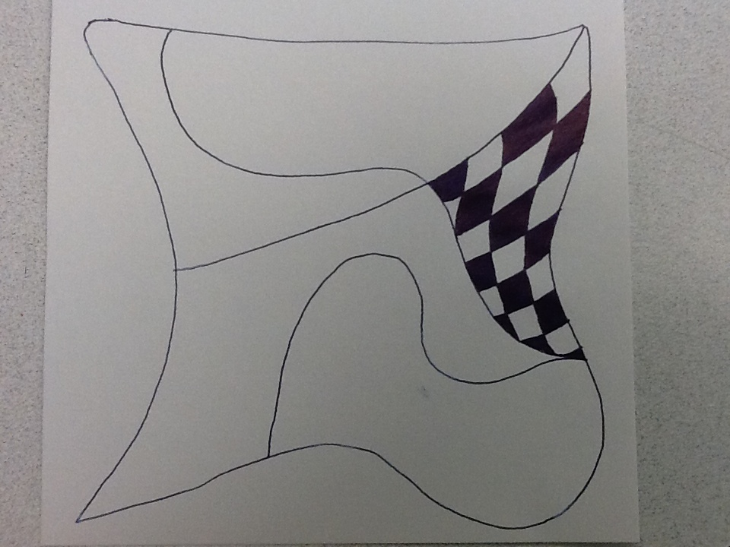
Step 4: Start filling in spaces with Zentangle designs.

Slide 6
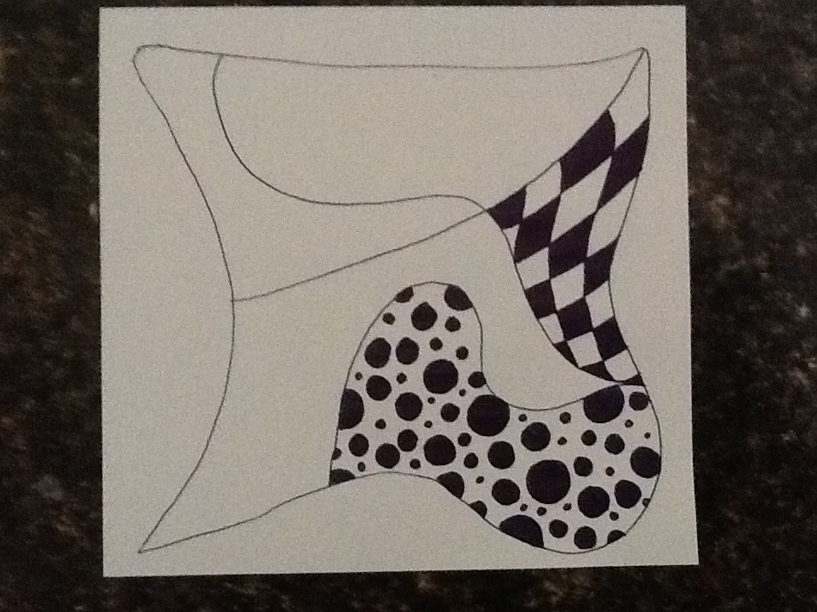
Step 5: Continue adding different designs into all the spaces

Slide 7
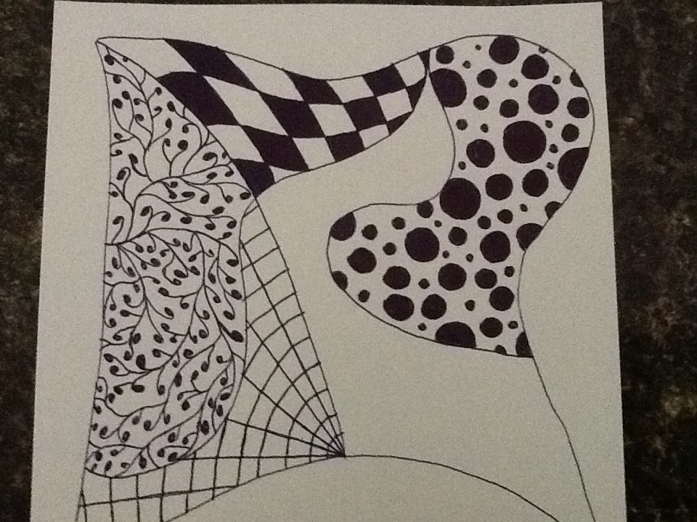

Slide 8
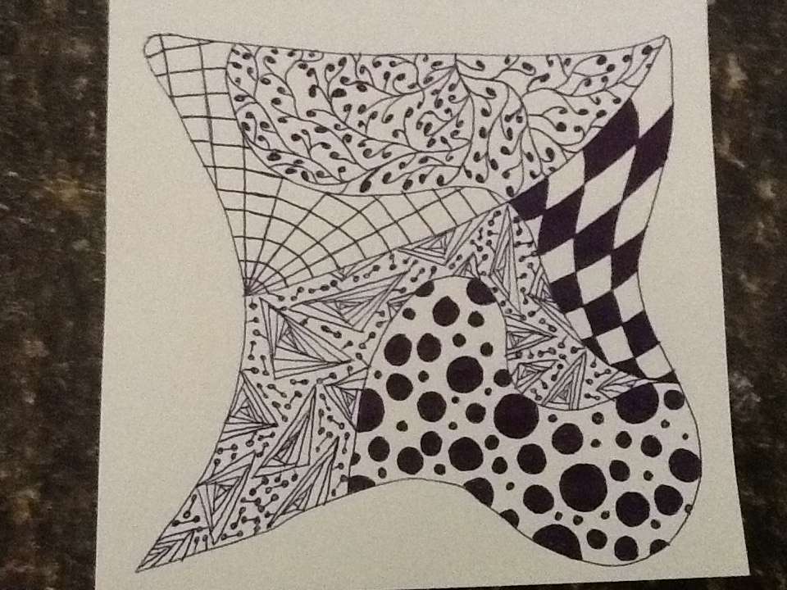
You are done!

Slide 9
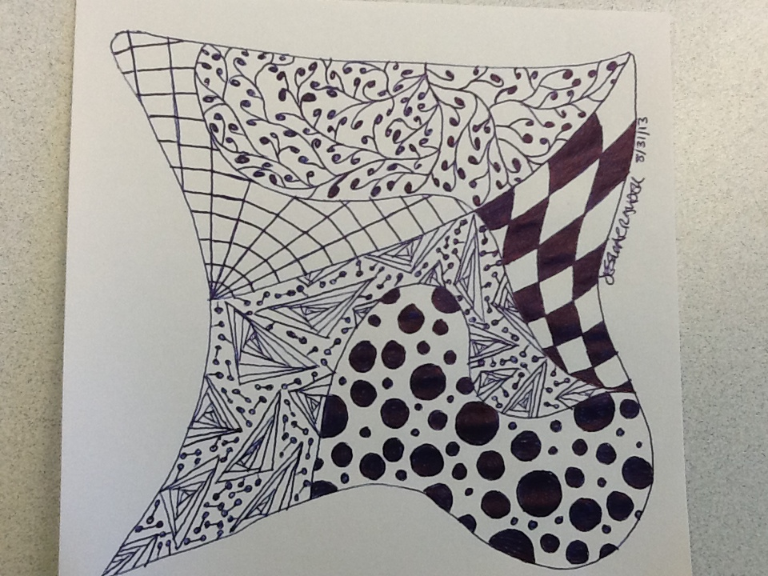
Don’t’ forget to sign and date your work!

