Slide 1
Cubism
Early 1900s

Slide 2
The Cubist Movement
Art should not copy nature
Rejection of traditional techniques
Emphasis of 2 dimensions
Break down into geometric shapes
Various Vantage Points

Slide 3
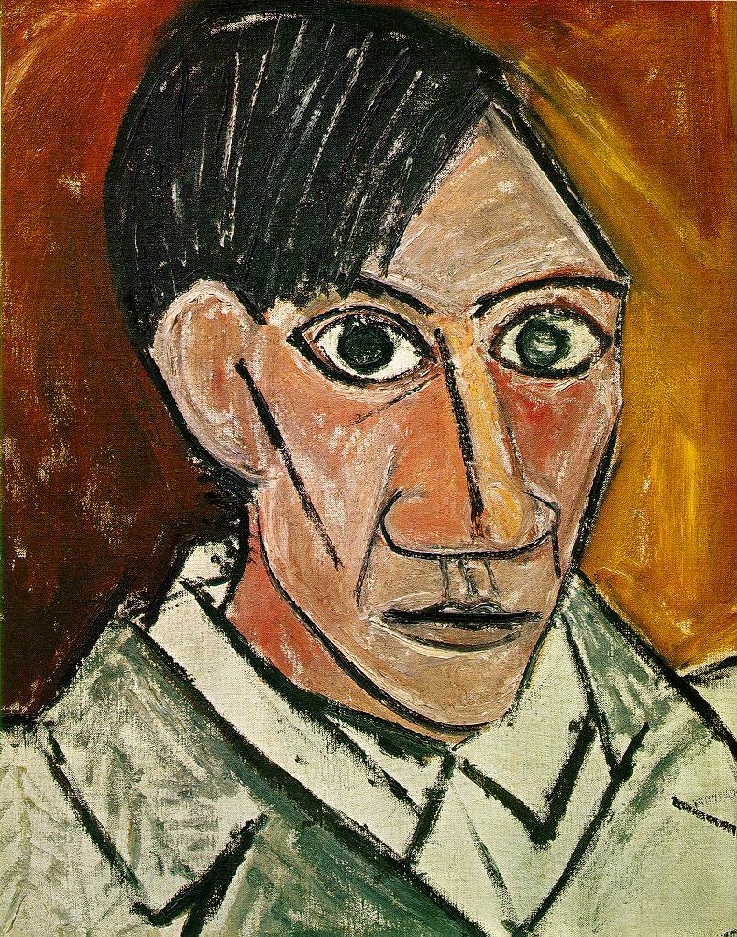
The KING of Cubsim
Pablo Picasso
Self Portrait, 1907

Slide 4
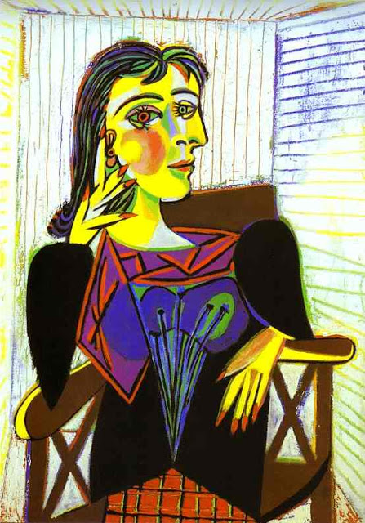
Pablo Picasso
Portrait of Dora Maar
1937

Slide 5
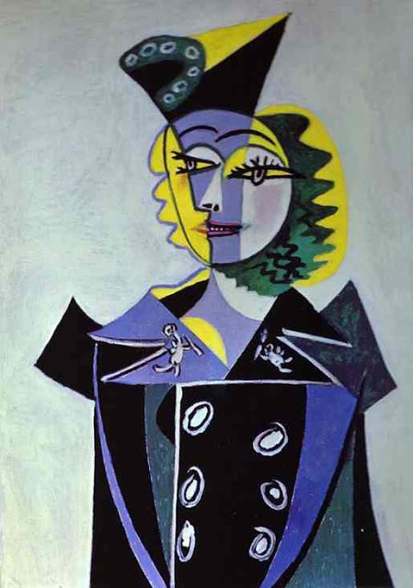
Pablo Picasso
Nusch Elouard
1937

Slide 6
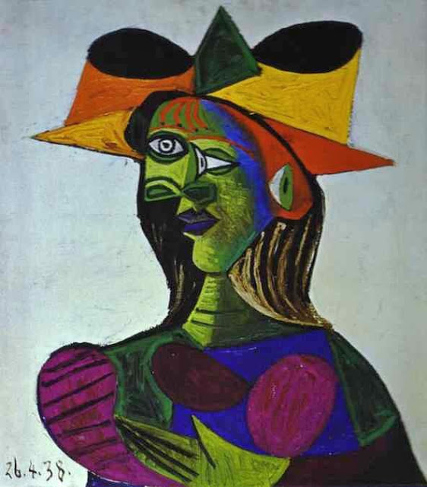
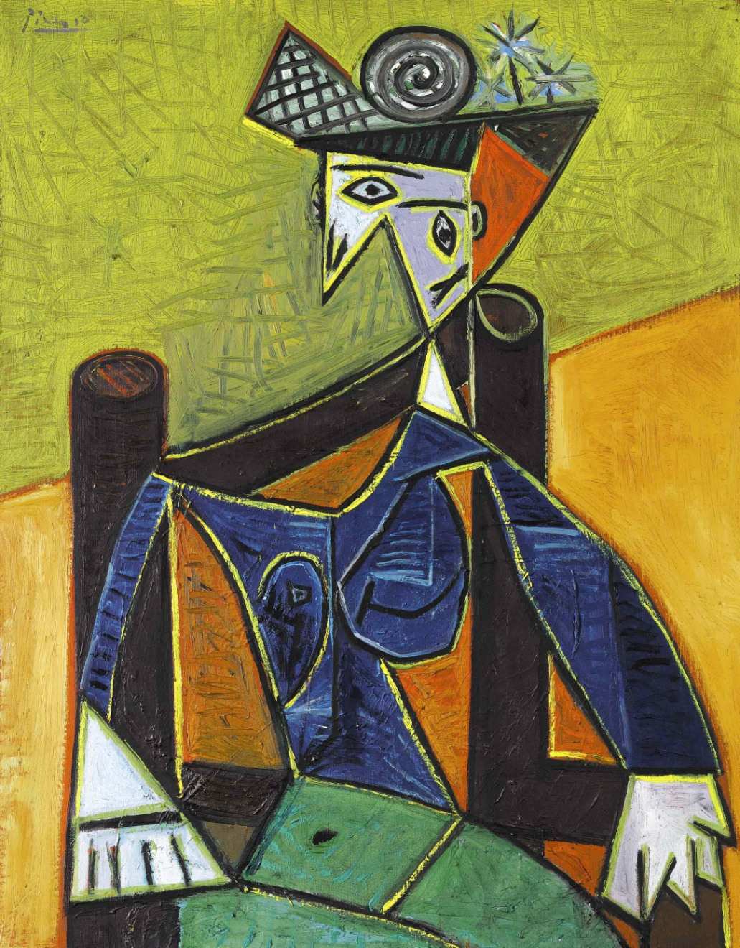
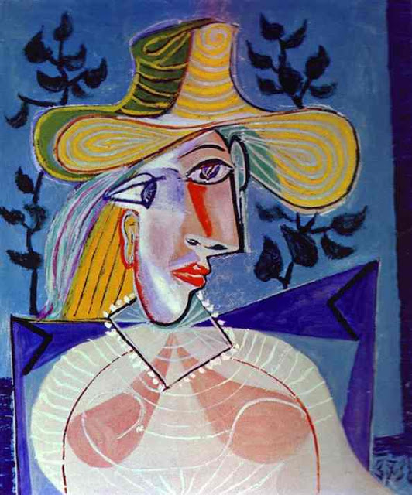
So..why was this a big deal???

Slide 7
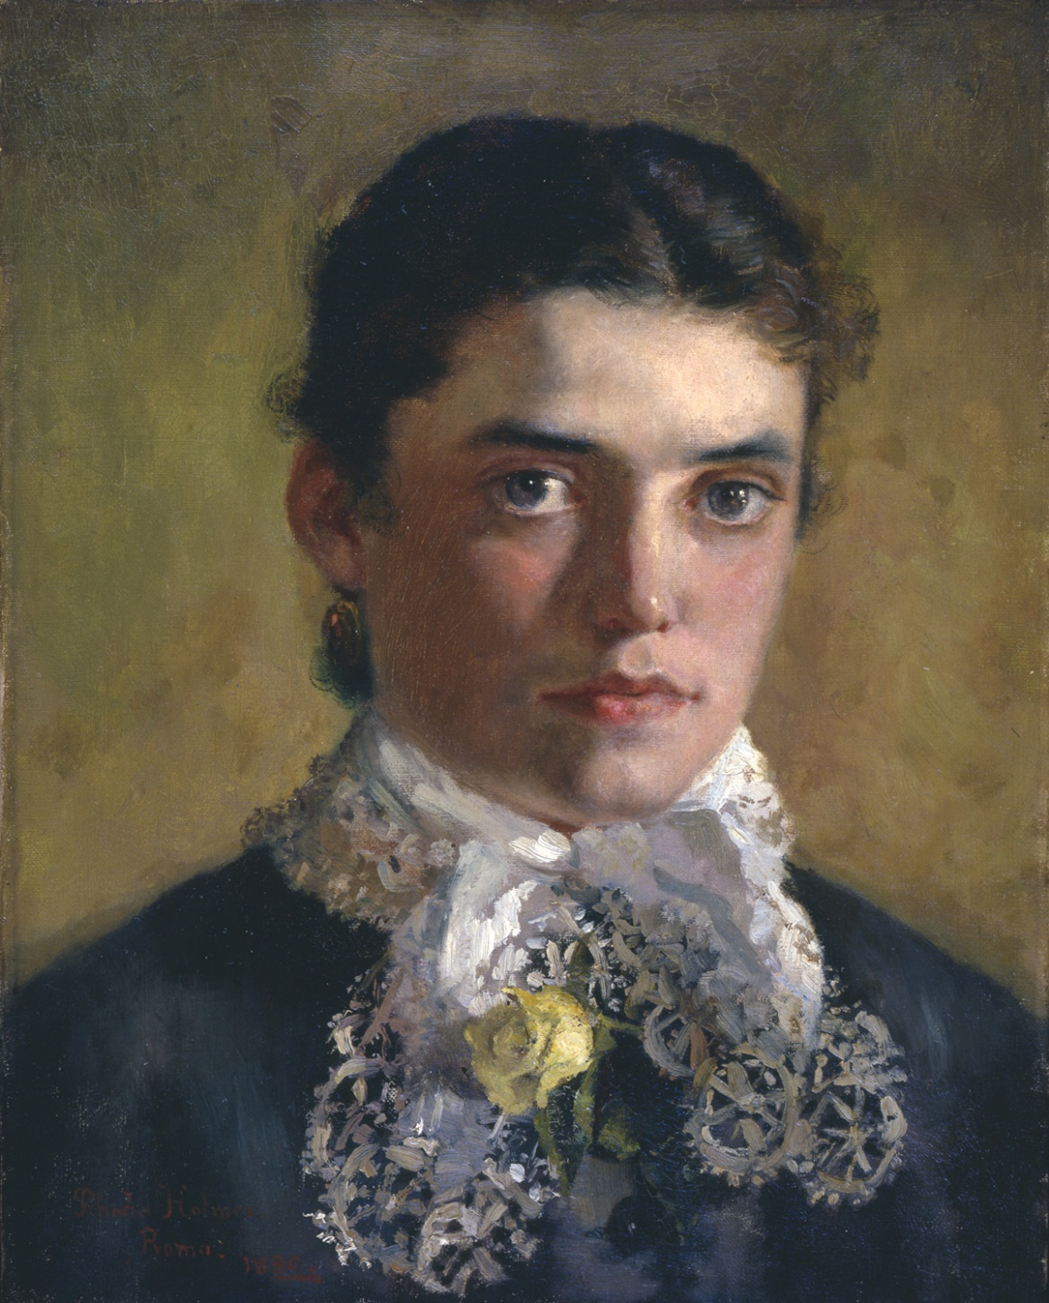
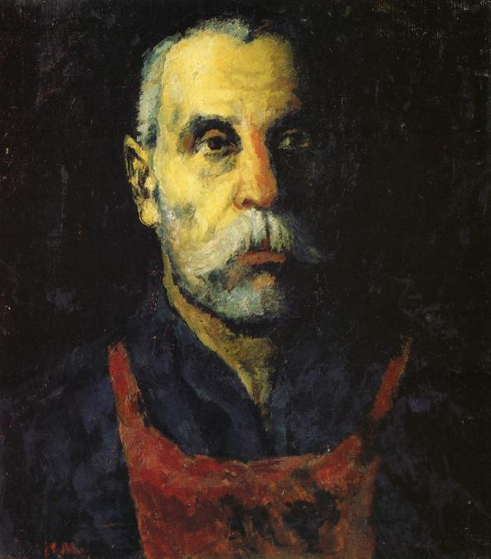

Slide 9
Not copy nature
Rejection of traditional techniques
Emphasis of 2 dimensions
Break down into geometric shapes
Various Vantage Points

