Slide 1
Abstract Art

Slide 2
What is it exactly?
Abstract art can be a painting or sculpture that does not depict a person, place or thing in the natural world -- even in an extremely distorted or exaggerated way.
Many different sub-categories
Often holds a secret meaning for the artist that is unknown to everyone else.

Slide 3
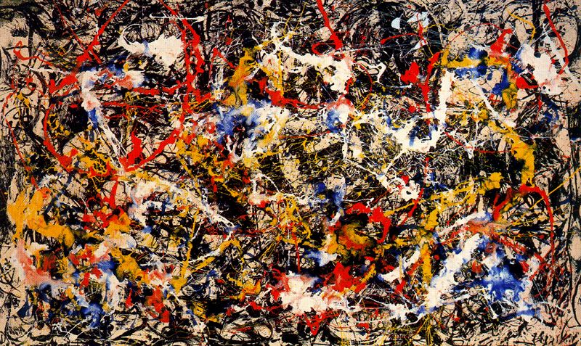
Abstract Expressionism
Jackson Pollack
Convergence, 1952

Slide 4
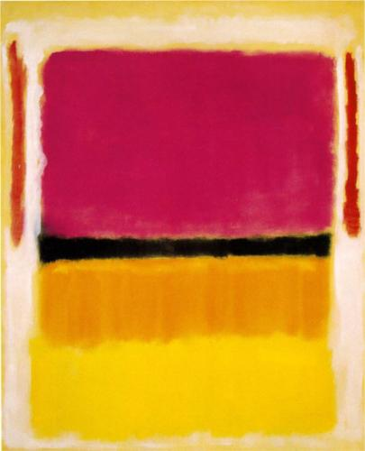
Abstract Expressionism
Violet, Black, Orange, Yellow on White and Red, 1949
Mark Rothko

Slide 5
Abstract Expressionism
Large-scale canvases are about the action of painting
the canvas was meant to be the product of an artist’s specific interaction with materials
“my kindergartener could have drawn that”
very intentional approaches of these artists and their tortured personal lives

Slide 6
Minimalism
Often used color to convey meaning and emotion.
More “hard-edged”
Less about the process and more about the connection

Slide 7
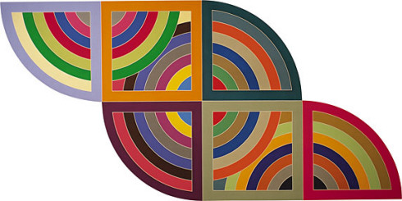
Minimalism
Harran II, 1967
Frank Stella

Slide 8
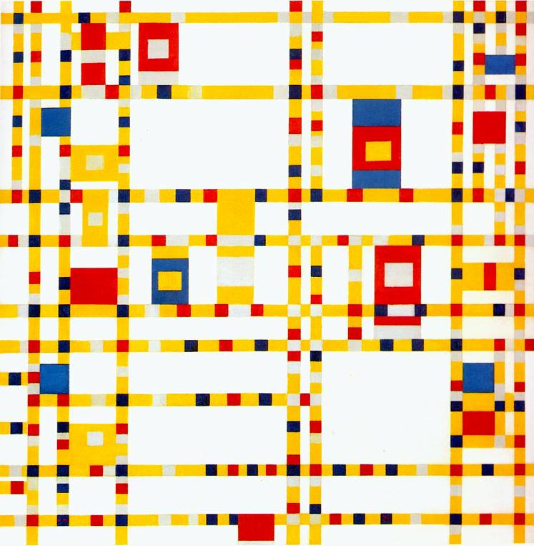
Minimalism
Broadway Boogie Woogie, 1942
Piet Mondrian

Slide 9
How to view it
“What is this about?” “What the heck am I looking at?!”
Think more creatively.
The piece can be “about” the paint on the canvas, the process of painting for an artist personally; it can even be about the meaning of abstract art itself!
mood-state or atmosphere?
What does it prompt you to think about?
Are you confronted with a particular color or shape?
How does what you’re looking at make you feel?
Subject of the work is based on what you see: color, shapes, brushstrokes, size, scale and, in some cases, the process.
Every viewer has a unique experience.
Depends on your mood and life experiences.

Slide 10
Let’s Try It!
Notes:
Teal Current

Slide 11
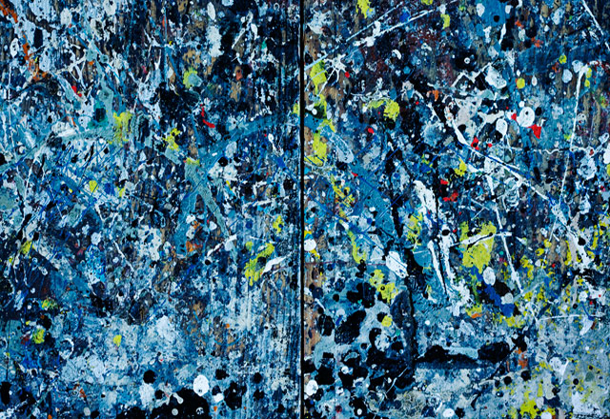
Let’s Try It!
Notes:
#3

Slide 12
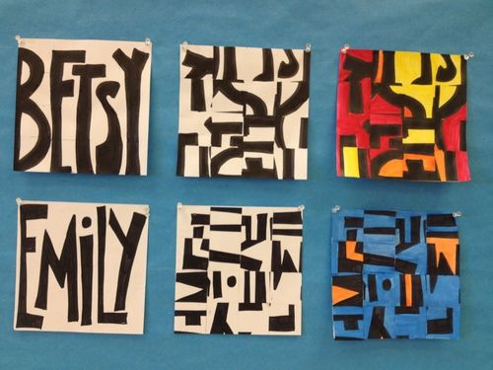
Your Project: Abstract Names
You will draw your name in bubble letters.
Color in name with Sharpie
Cut it up into squares.
Rearrange to create an interesting composition with attention
to positive and negative space.
Paint background with color.
EVERY ARTIST HAS THEIR SECRETS ☺

